Slide 1

Day Two Home Work Display
Jiaqi Li

Slide 2
Brief Introduction
code Pdf plot
3D Box-Muller
BTC-EUR history-prize and Candlestick chart
RF example

Slide 3
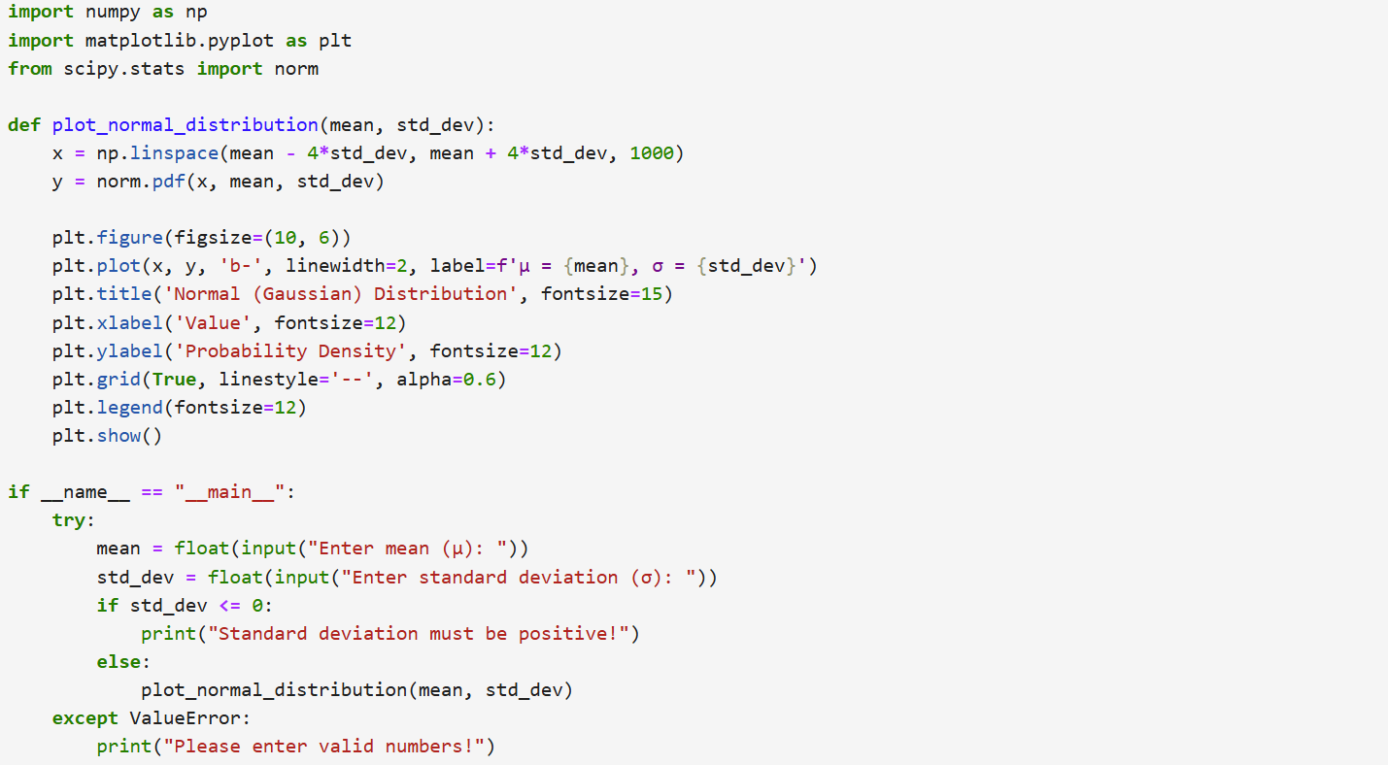
code Pdf plot:code

Slide 4
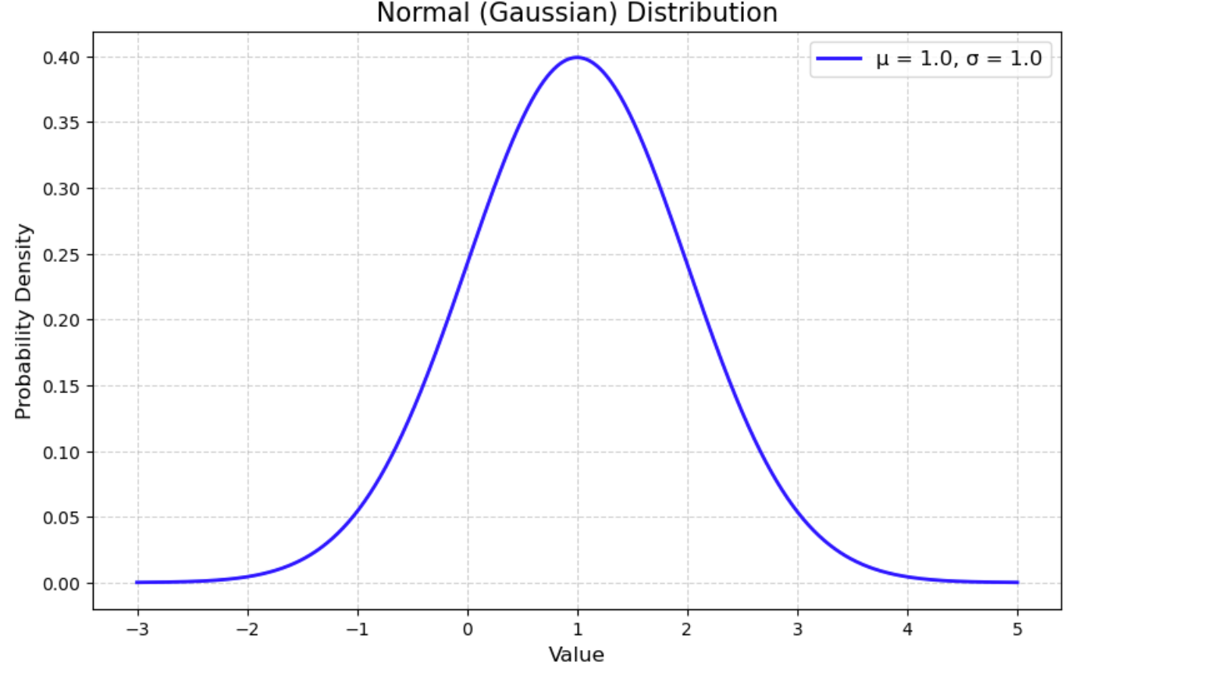
code Pdf plot:result
Mean=1,Standard deviation=1 situation:

Slide 5
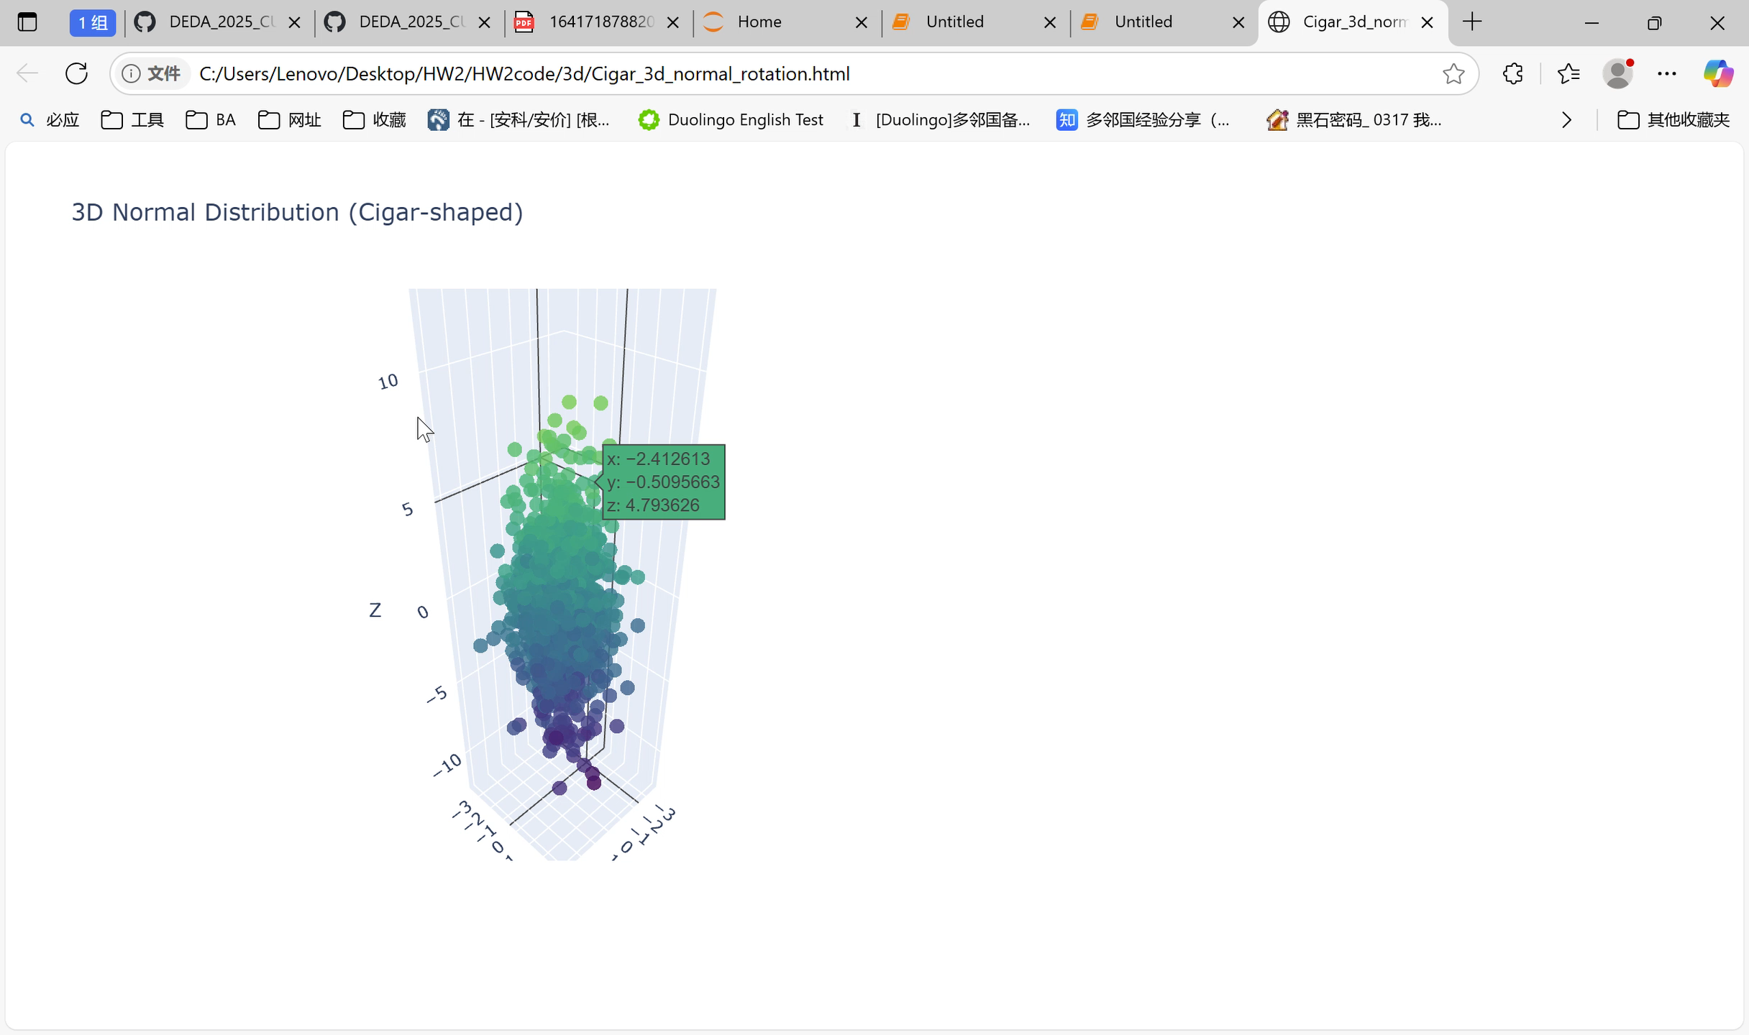
3D cigar

Slide 6
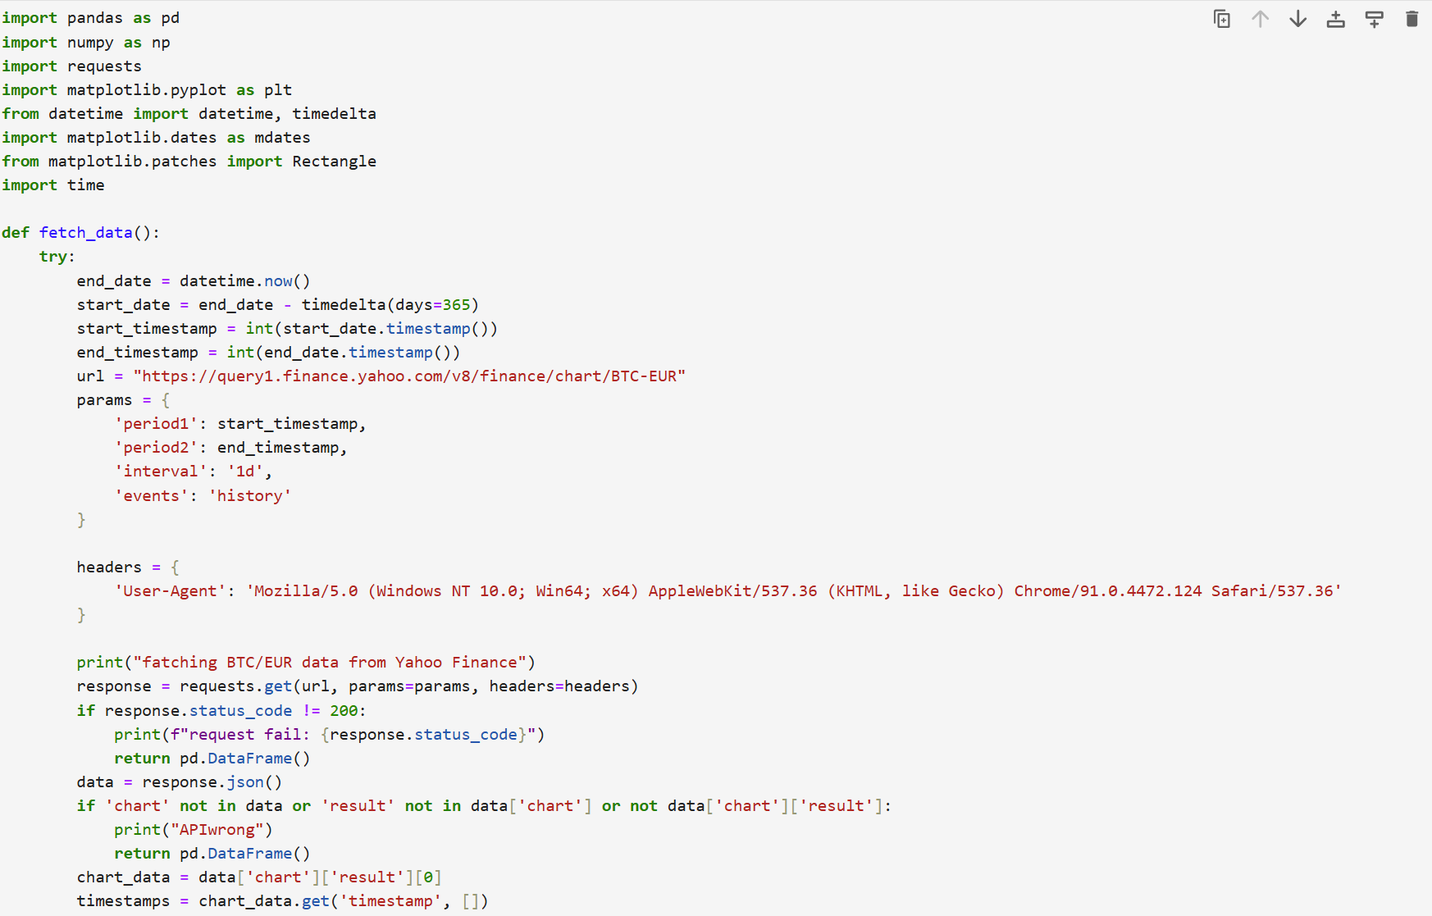
BTC-EUR history-prize and Candlestick chart:code

Slide 7
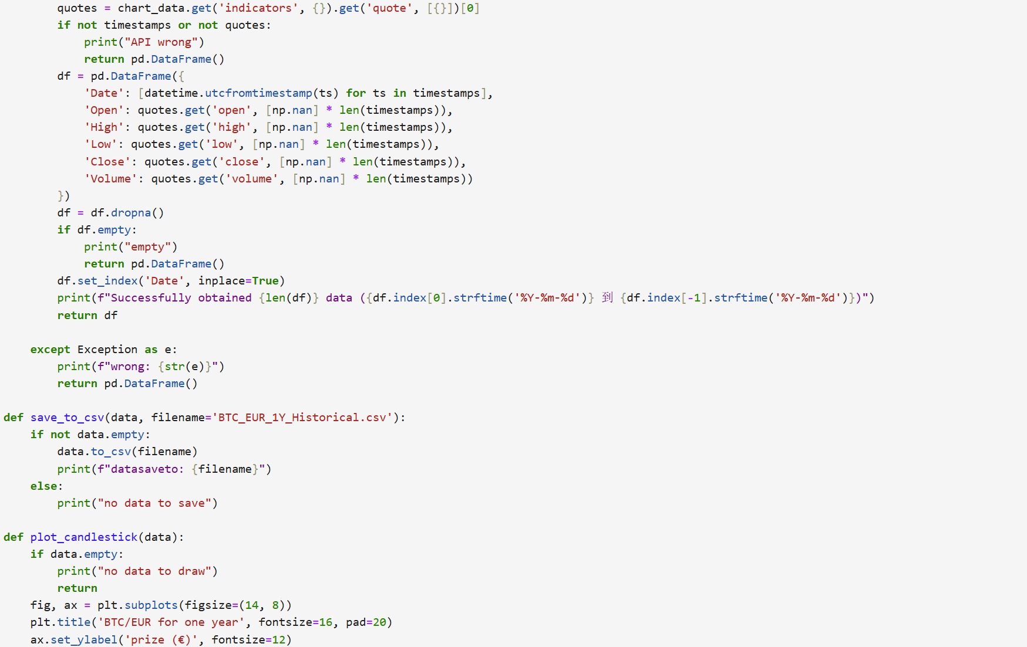
BTC-EUR history-prize and Candlestick chart:code

Slide 8
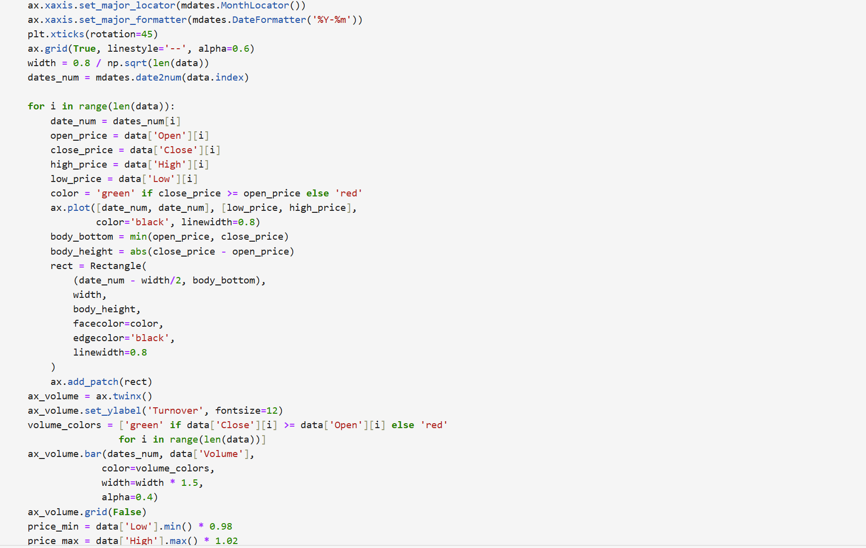
BTC-EUR history-prize and Candlestick chart:code

Slide 9
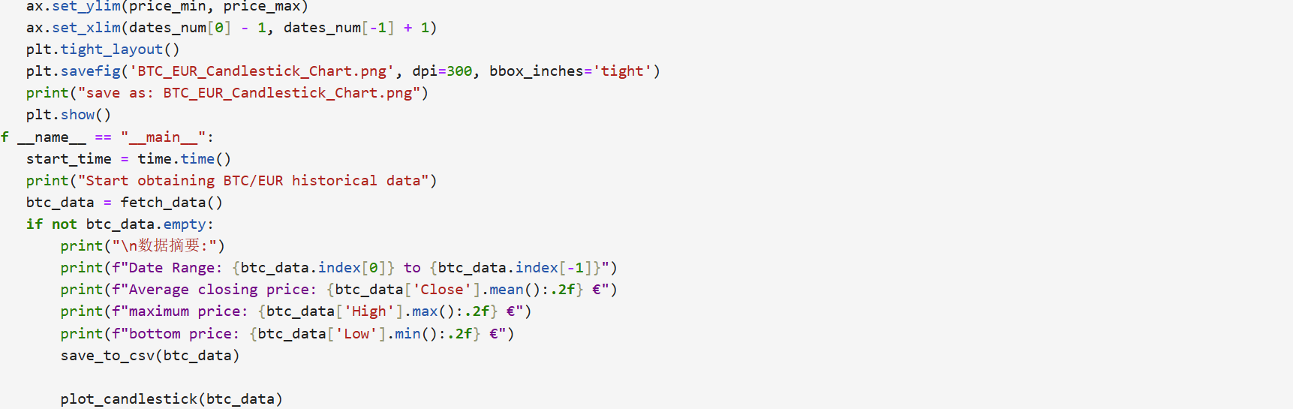
BTC-EUR history-prize and Candlestick chart:code

Slide 10
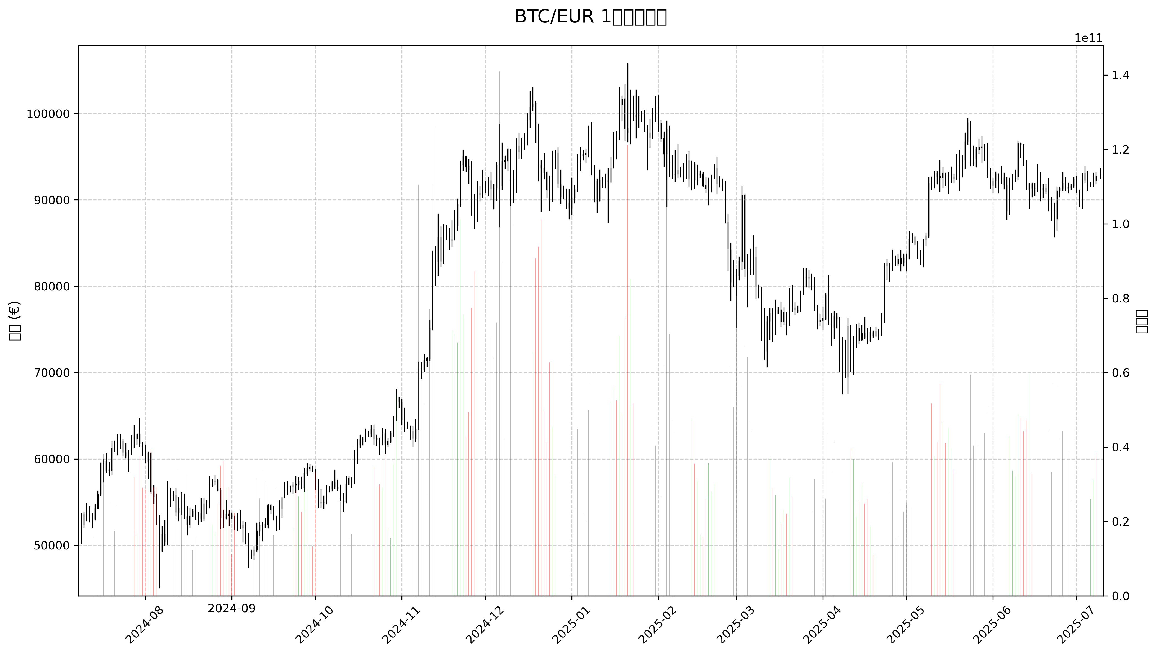
BTC-EUR history-prize and Candlestick chart:Candlestick chart

Slide 11
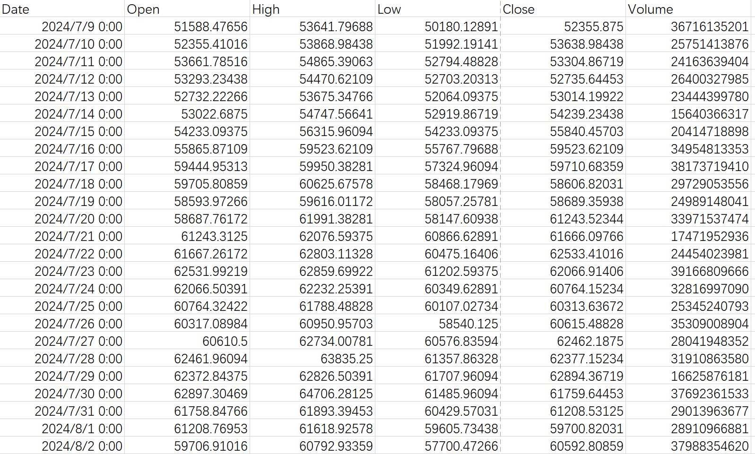
BTC-EUR history-prize :one year data in csv
Click here to down the full version
https://1drv.ms/f/c/a385f48945b25c58/Em9J-FXXiV1Eg1sI6XMqFgABDiEIZc3g0Re7_Mz6-g4wig?e=zHTe8Z

Slide 12
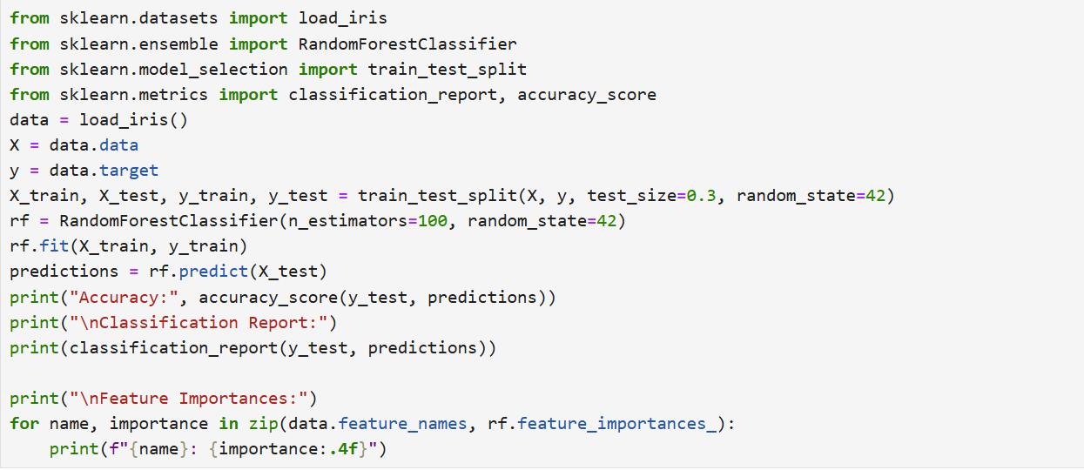
Random Forest example：code

Slide 13
Random Forest example：code

Slide 14
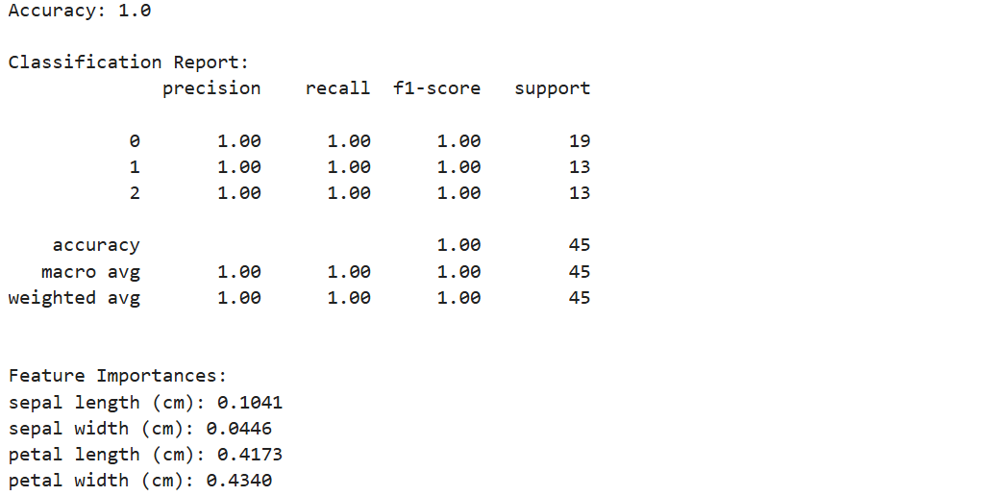
Random Forest example

